Slide 1
What contributes to a movie’s success ?
Business Analytics Project IEOR 4650
Mainak Pyne Sandhya Sriraman Karan Viegas Kartik Vyas

Slide 2


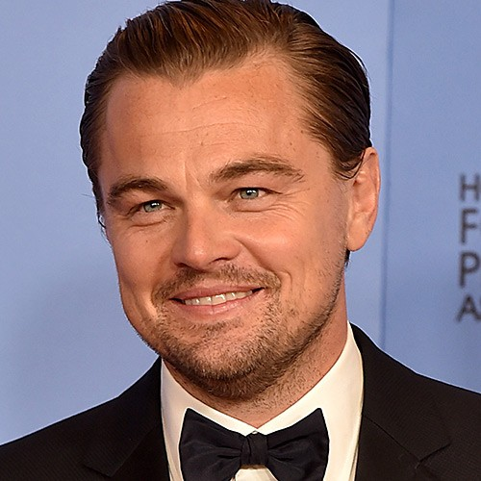

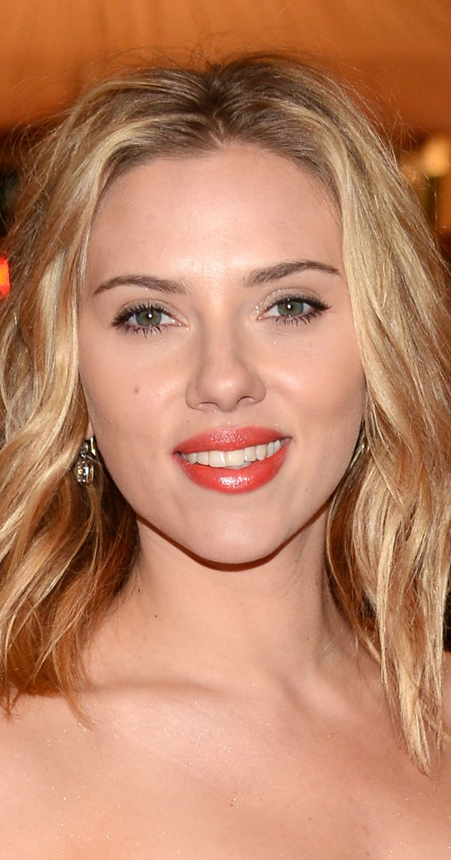







Problem Statement – Business Relevance

Slide 3
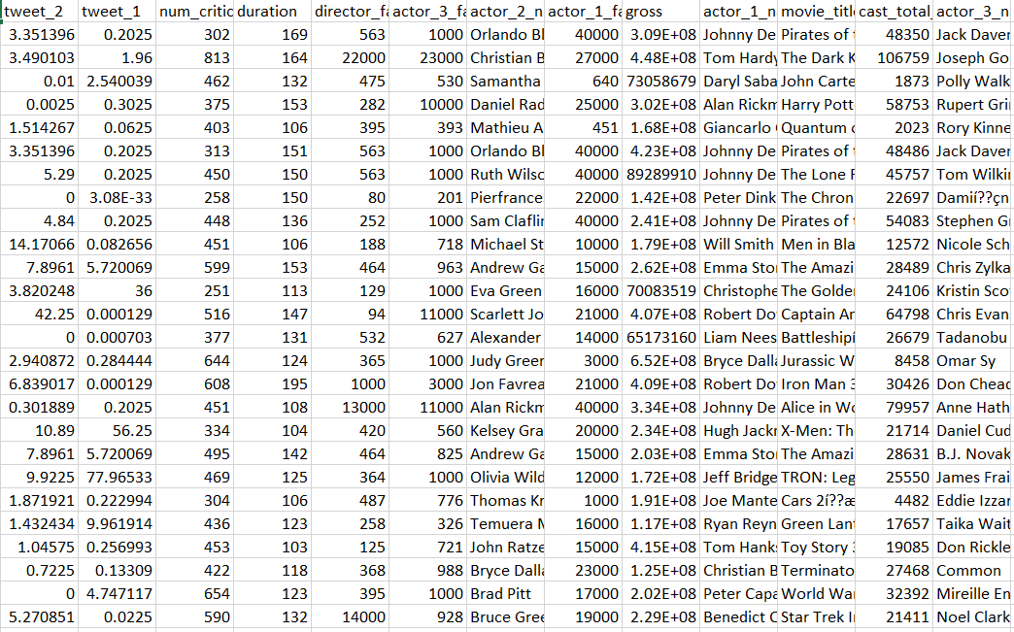
Data Handling
Data collection
Movie Meta Dataset
Hadley Wickham’s Normalized IMDB Movie Data
Web Scrapping
Data Cleaning
Formulation
Award score = 1*(0.3*OAN + 0.7*EAN) + 4*(0.3*OAW + 0.7*EAW)
Publicity score = Actor Publicity Score = 10*B + 5*M + 1*(I + MA + A)
Final Dataset
OA = Ordinary Award Nominations
EA = Extraordinary Award (Oscars, Golden Globes, BAFTA) Nominations
OA = Ordinary Award Wins
EA = Extraordinary Award (Oscars, Golden Globes, BAFTA) Wins
The top 3 awards in the film industry Oscars, Golden Globes and BAFTA were considered and both nominations and wins were weighted relatively.
B = Biographies; M = Magazine covers; I = Interviews; MA = Media appearances; A = Articles
Notes:
Award score formula

Slide 4
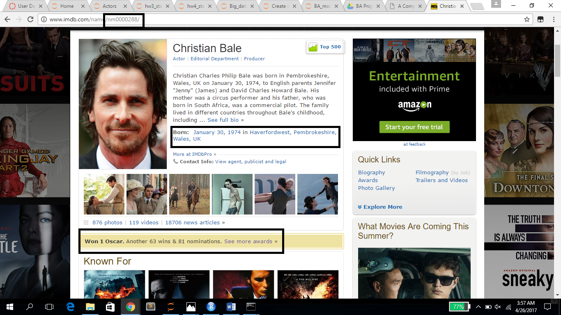
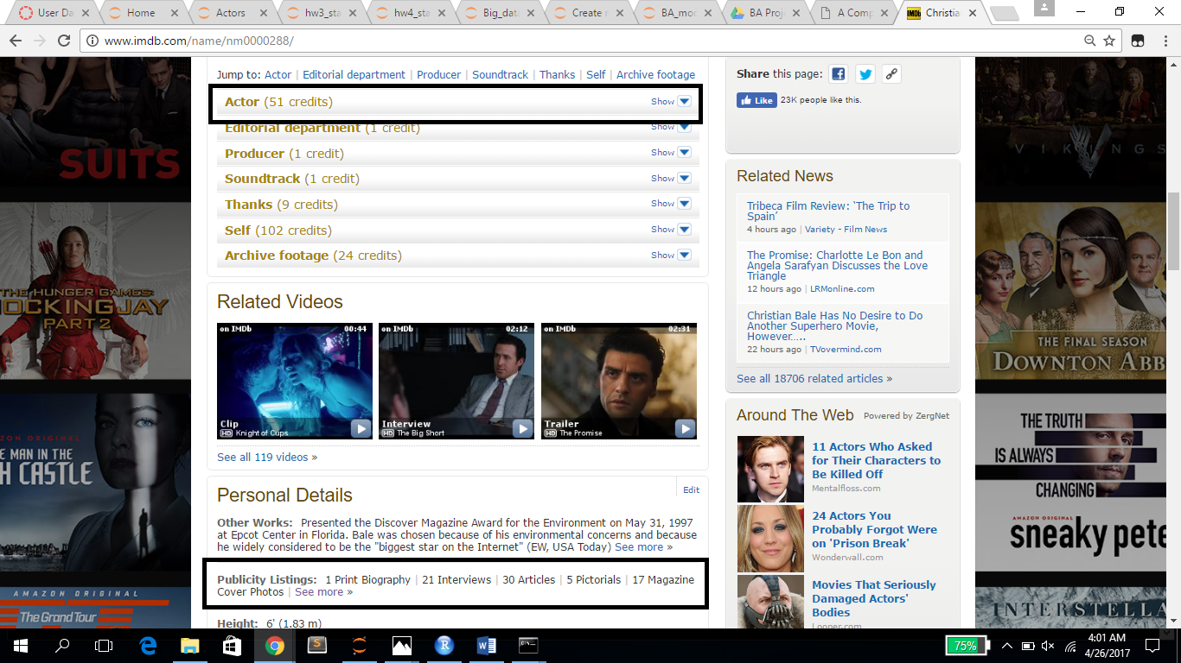
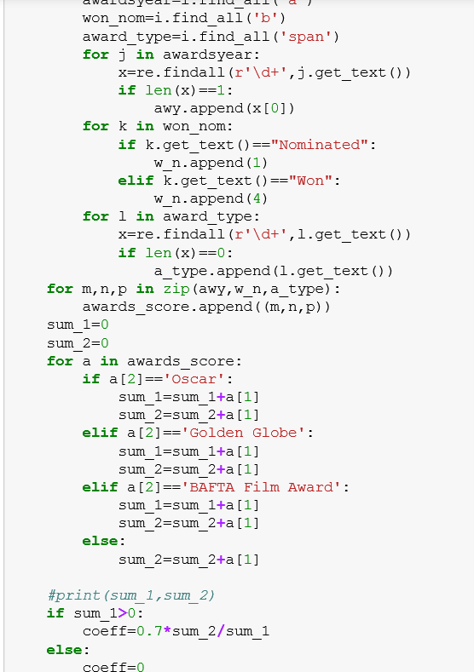
Data Handling - IMBD Web Scraping

Slide 5
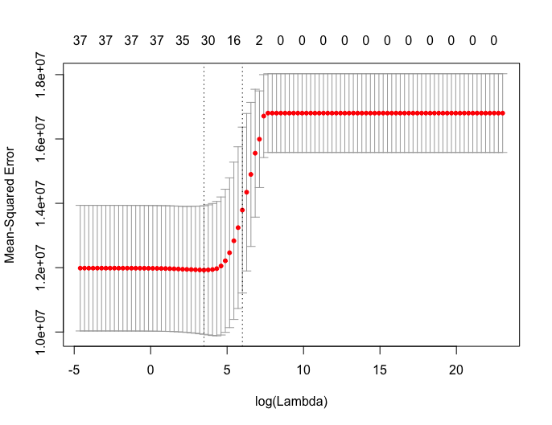
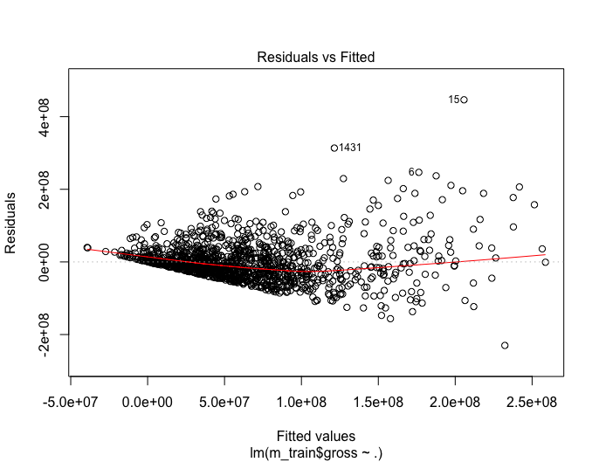
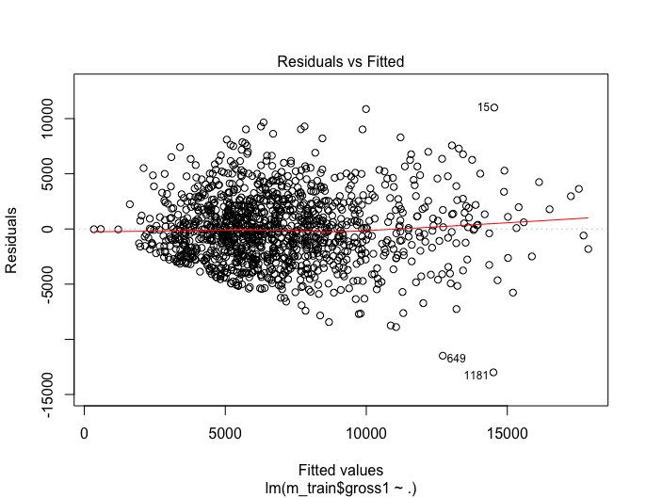
Modelling – Linear Regression
Gross ~.
√Gross ~.
√Gross ~ signif features
Residual standard error: 55040000 on 1218 DF
Multiple R-squared: 0.4451
Adjusted R-squared: 0.4282
F-statistic: 26.41 on 37 and 1218 DF
p-value: < 2.2e-16
MSE = 3.244693e+15
Heteroscedasticity!
Residual standard error: 3091 on 1218 DF Multiple R-squared: 0.4478
Adjusted R-squared: 0.431
F-statistic: 26.69 on 37 and 1218 DF
p-value: < 2.2e-16
MSE = 11033416
Residual standard error: 3085 on 1231 DF
Multiple R-squared: 0.444
Adjusted R-squared: 0.4331
F-statistic: 40.96 on 24 and 1231 DF
p-value: < 2.2e-16
MSE = 10948781
Residuals vs. Fitted values
Residuals vs. Fitted values
Lambda vs. MSE

Slide 6
Linear Regression
Coefficient Estimate p-value
num_critic_for_reviews 1.261e+01 < 2e-16 ***
duration 3.757e+01 1.39e-13 ***
facenumber_in_poster -1.192e+02 0.035597 *
director_facebook_likes 6.448e-02 0.024145 *
actor1_age 3.929e+01 1.21e-08 ***
actor1_publicity 8.047e-01 0.020499 * actor_2_facebook_likes 4.725e-02 0.004832 **
Action 9.142e+02 0.000278 ***
Adventure 9.736e+02 0.000382 ***
Fantasy 6.422e+02 0.030360 *
Comedy 9.879e+02 5.61e-05 ***
Family 2.408e+03 9.12e-10 *** Drama -1.301e+03 1.50e-08 ***
Horror -7.804e+02 0.033060 *
.
.
.
Movie Features
Director & Actor Publicity
Genre

Slide 7
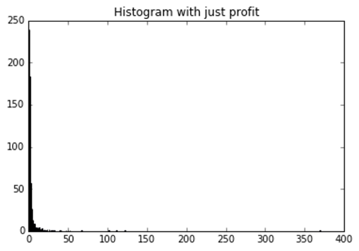
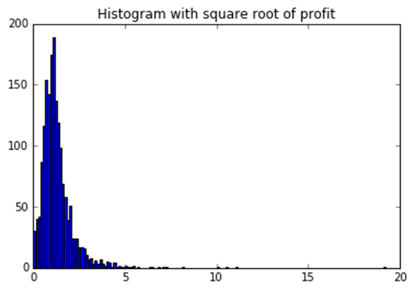
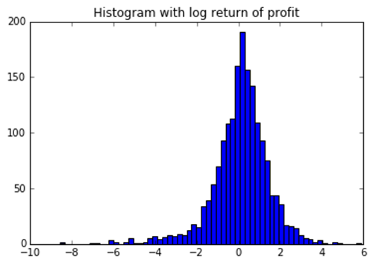
Modelling – K Mean Clustering
Distribution of profits
Distribution of square roots of profits
Logarithmic Distribution of profits
Profit distribution is skewed
Square root of distribution helps but could be improved
Finally, logarithmic of the distribution works well and can be used for K means

Slide 8
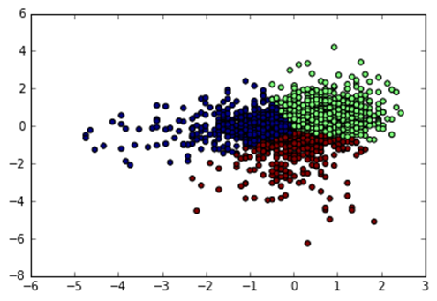
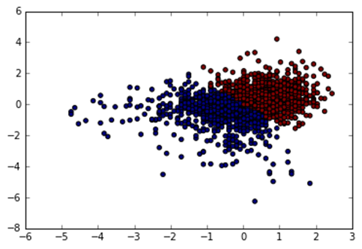
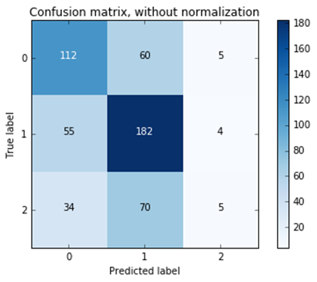
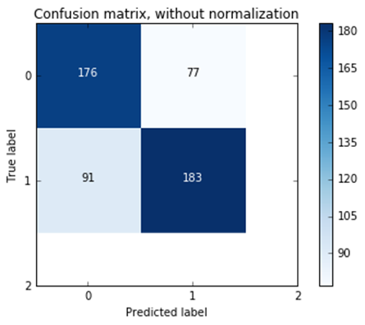
Modelling – K Mean Clustering
Clear difference in the true positives
Much higher for 2 clusters
We chose to continue our analysis with 2 clusters
Based on this classification, thresholds are decided

Slide 9
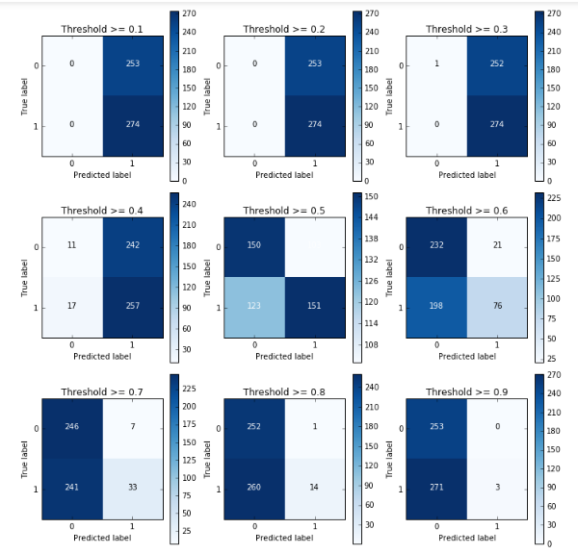
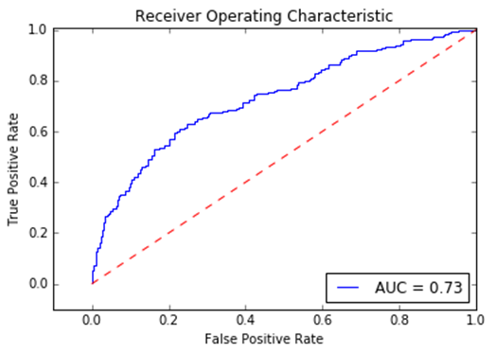
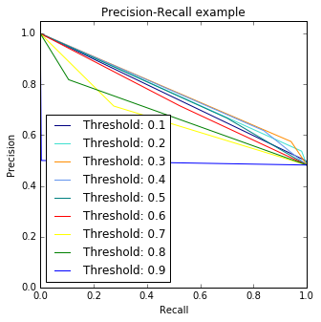
Confusion at different thresholds
For every parameter we found the mean recall volume and score using K-fold cross validation, after which we plot the confusion matrices with different thresholds
Confusion matrices

Slide 10
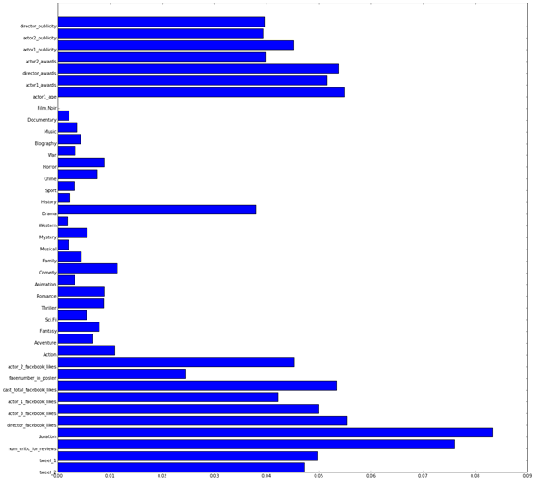
Random Forest
Duration and number of critic for reviews are more important!!!
This suggests that getting more reviews from critics or inviting more critics to premieres can have a positive impact on the success of a movie
Relative importance of genres can be useful for production houses to make decisions
Array
([ 0.05, 0.05, 0.08, 0.09, 0.07, 0.05, 0.06, 0.03, 0.05,0.01, 0.01, 0.01, 0.01, 0.01, 0.01, 0. , 0.01, 0. ,0. , 0.01, 0. , 0.02, 0. , 0. , 0.01, 0.,0.0., 0., 0., 0.,0.05, 0.05, 0.06, 0.05,0.05,0.04, 0.04])
Feature importance

Slide 11
Conclusion
Based on our model, we recommend producers to concentrate on getting more critics for reviews and on the duration of a movie.
In terms of actors, it helps to have actors who are older (viz. More experienced) and are in general more popular in the entertainment industry.
In terms of genres, family, comedy and action movies generate more revenues and are more successful as opposed to thrillers or horror movies.
Finally, this model is only a heuristic for prediction and should not be considered too literally.

Slide 12
Thank you!

Slide 13
Appendix

Slide 14
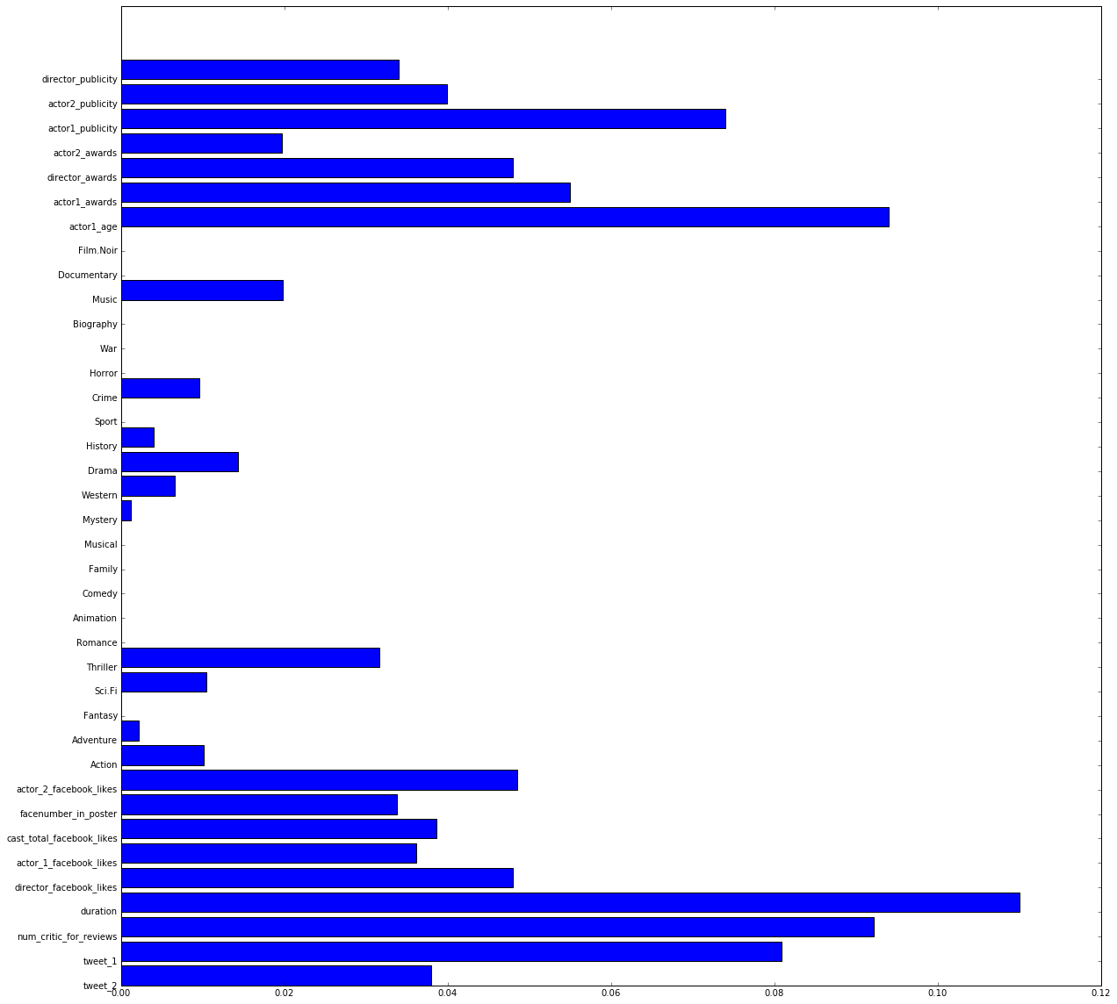
Decision Tree
Decision tree has a depth of 9
Depth decided based on mean scores
Features considered in decision trees are depicted in graph

Slide 15
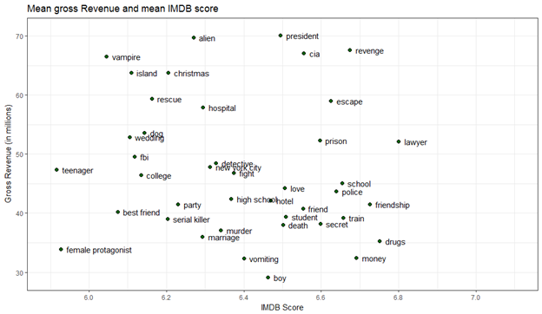
Revenue vs Plot Keywords

